Slide 1

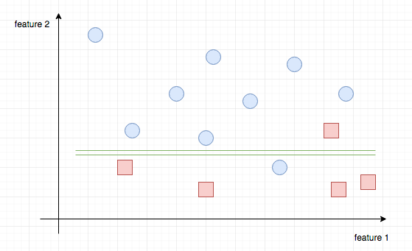
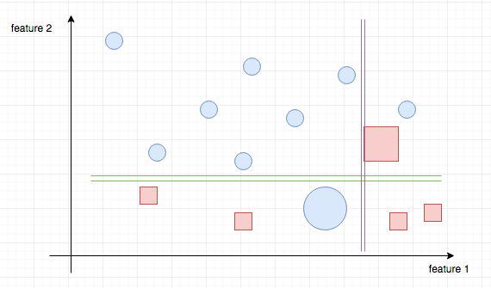
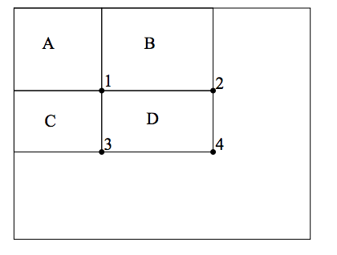
Viola Jones Face Detection Algorithm
Authors: Augustus Chang & Niral Shah
Professor: Anand Sarwate
Date: 12/12/2016
Abstract
Methodology
This poster outlines the results and findings of a semester long project for ECE’s Signal & Data Analysis course. Our group decided to understand a machine learning approach for rapid object detection, specifically for faces. The project explores the Viola Jones algorithm for face detection proposed by Paul Viola and Michael Jones. Central to this algorithm is Robert Schapire’s concept of boosting weak classifiers, specifically constructed from Haar-like features, so as to construct a strong classifier. To gain a proper understanding the algorithm was reconstructed from scratch in Python.
The Viola Jones Face Detection Algorithm
2. Integral Image
3. Adaboost & Weak Classifiers
As a supervised learning algorithm, the CMU Frontal Face Data Set was used. The training set and test data was pulled from this dataset.
1. Feature Selection and Extraction
Figure one (left) demonstrates the various Haar Feature Types. Each Haar feature is varied in size within a sub-window and the resulting feature is represented by the difference in area between the white region and gray region.
Figure 4
An Integral Image is a representation of an image where each pixel is changed to the sum of the pixels to the left and above it. This allows us to calculate the areas of the white region and gray region in a Haar feature.
Figure 1
Figure 5
Figure 6
Figure two (right) illustrates how a Haar Feature is applied in a sub-window (represented by the blue box) to the image. Each feature type is varied in size within the sub-window. As a there are over 100,000 features in a 24x24 sub-window. The sub-window is applied across the image.
Integral Area_{D} = (P₄ + P₁) – (P₃ + P₂ )
Stage 1
Stage 2 and Beyond
Figure three (left), shows the corresponding Integral Image to the image in Figure two.
In stage 1 of this simplified example, Adaboost selects the best weak classifier based on feature 1. The horizontal line represents the threshold. All features above this threshold are deemed to be circles, and all features below, squares. It only misclassifies one square and one circle.
In stage 2, Adaboost gives higher weights to the two misclassified points, so the next best weak classifier is encouraged to get the two points correctly. This time, the weak classifier is based off of feature 2. This process is continued for every iteration of Adaboost. So if N distinct features are used, the plots will be separated in N dimension. This repeats for several iterations. The original paper proposed 200 iterations.
Figure 2
Figure 3
Background
Results
Future Direction
This section contains some of the notable mathematical equations involved with this algorithm.
In this current algorithm, once the features are extracted and the integral image is constructed, Adaboost uses weighting to isolate weak classifiers to construct a strong classifier for face detection. This approach is computationally heavy and inefficient. The original creators, Paul Viola and Michael Jones proposed an improvement to allow this algorithm to run on low powered CPUs. Instead of considering every single weak classifier generated by the image, Cascading Classifiers simply considered a subset of these classifiers in several stages. If at any stage the classifiers do not detect a face then the classification is complete. Otherwise it continues till high confidence of a face detection is reached.
Equation 1
Equation (1) refers to how Adaboost creates Weak Classifiers.
Equation 2
Equation (2) refers to how Adaboost takes the weak classifiers, applies weighting to them (via the coefficients) to construct a strong classifier.
References
1. Rapid Object Detection Using a Boosted Cascade of Simple Features (Paul Viola and Michael Jones), Figure 1 :
https://www.cs.cmu.edu/~efros/courses/LBMV07/Papers/viola-cvpr-01.pdf
2. Explaining Adaboost (Robert Schapire):
http://rob.schapire.net/papers/explaining-adaboost.pdf
3. Boosting Notes (Professor Patrick Winston):
https://ocw.mit.edu/courses/electrical-engineering-and-computer-science/6-034-artificial-intelligence-fall-2010/readings/MIT6_034F10_boosting.pdf
4. CMU Frontal Face Dataset : http://vasc.ri.cmu.edu/idb/html/face/frontal_images/
5. (Figure 4) : Integral Image https://computersciencesource.files.wordpress.com/2010/09/adding_3.png
Acknowledgements
Dr. Paul Viola and Dr. Michael Jones (MIT)
Robert Schapire (Princeton)
Professor Anand Sarwate (Rutgers)
Professor Kristin Dana (Rutgers)
Professor Patrick Winston (MIT)

